Slide 1
Stroke
Traumatic Brain Injury
Spinal Cord Injury
Amyotrophic Lateral Sclerosis
Multiple Sclerosis
Cerebral Palsy
Muscular Dystrophy
Amputation

Slide 4
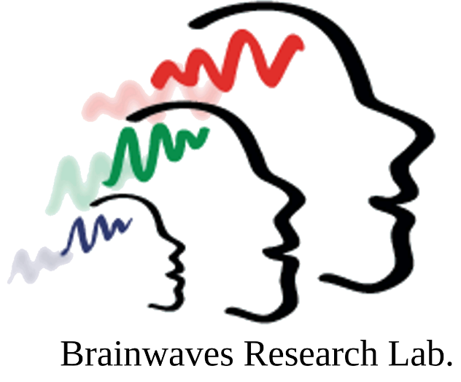
Computer Science
Human Development and
Family Studies
Occupational Therapy

Slide 5
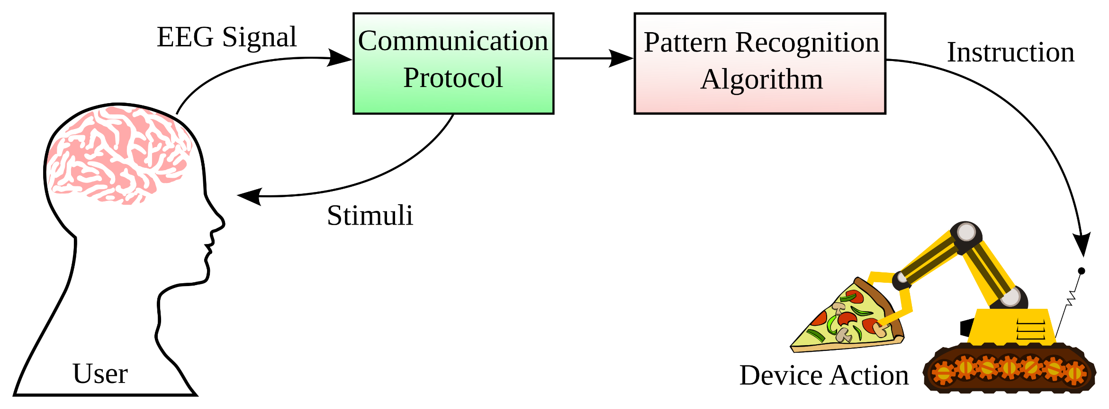
Brain-Computer Interfaces (BCI)

Slide 6
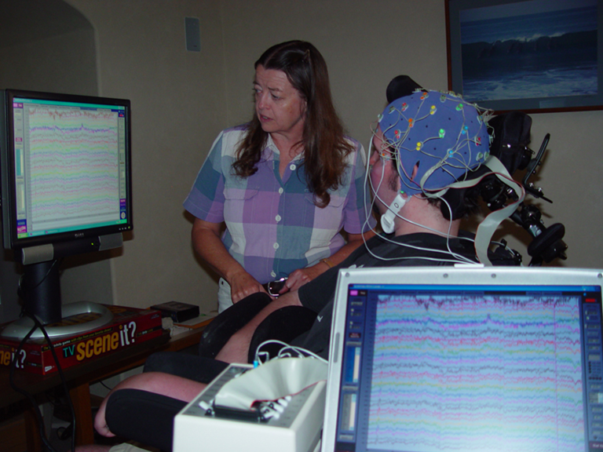
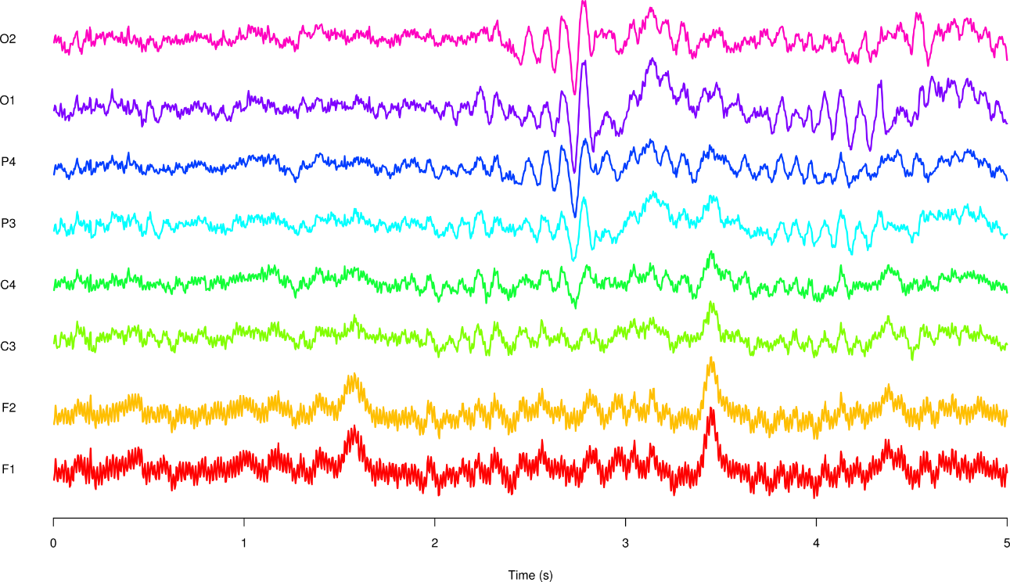
Electroencephalography (EEG)

Slide 7
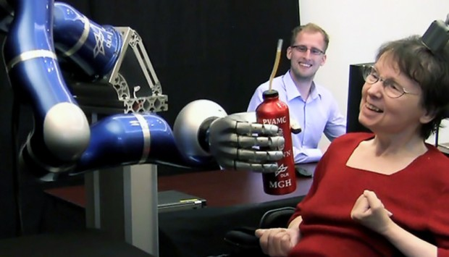
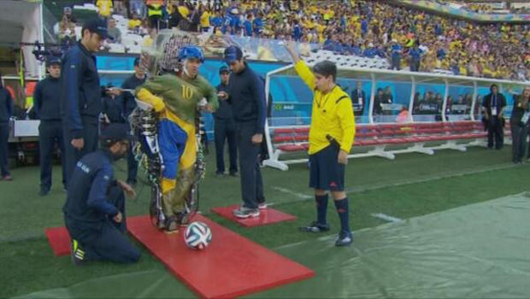
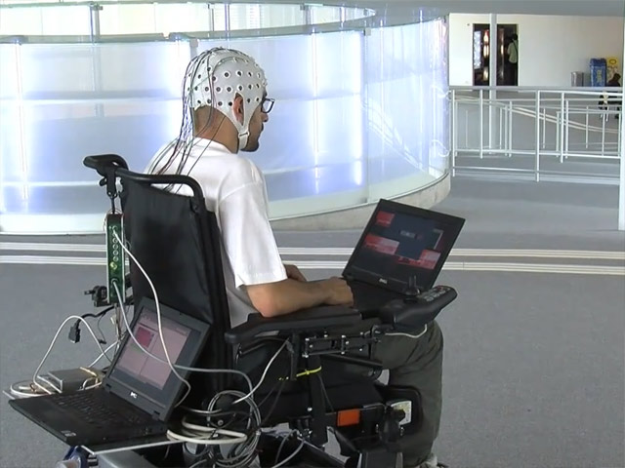
Long-Term Goals
BrainGate Project
http://braingate2.org
Walk Again Project
http://www.nicolelislab.net/
http://virtualreality.duke.edu/project/walk-again-project/
Defitech Foundation Chair in Non-Invasive Brain-Machine Interfaces
Swiss Federal Institute of Technology
http://cnbi.epfl.ch/

Slide 9
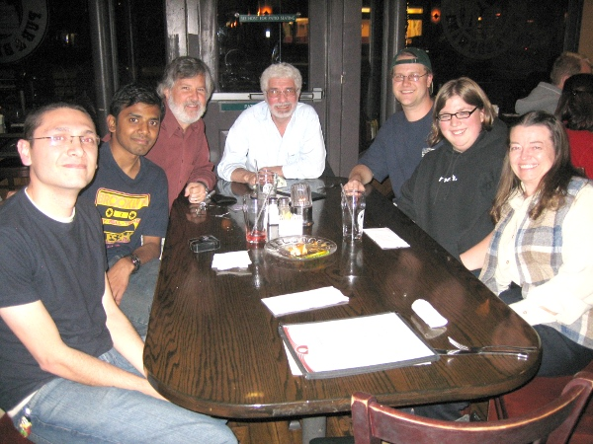
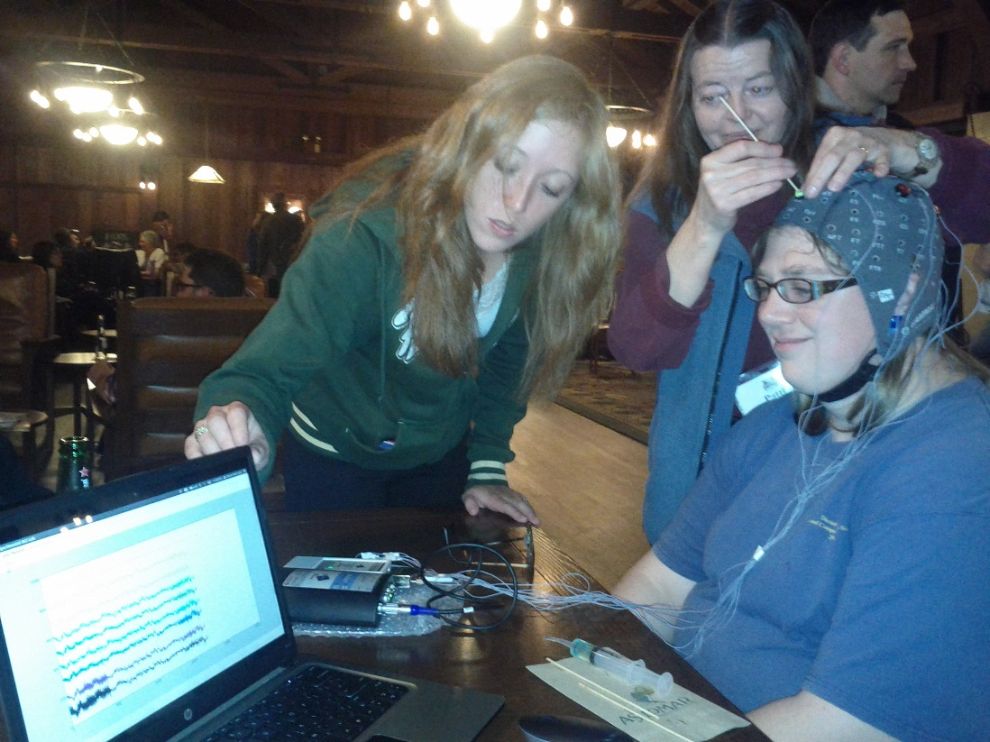
Thank You!
BCI Lab Team:
Charles Anderson
William Gavin
Patricia Davies
Marla Roll
Elliott Forney
Brittany Taylor
Jewel Crasta
Fereydoon Vafaei
Tomojit Ghosh

