Slide 1
Brain-Computer Interfaces: Demonstrations and Discussions of Applications
Chuck Anderson, Patti Davies, Marla Roll,
William Gavin, Elliott Forney, Colin Heffern
Colorado State University
Fort Collins, Colorado, USA
RESNA 2015
Denver, Colorado

Slide 2
Learning Outcomes of Workshop
Participants will understand the kind of equipment necessary for BCI by observing the live demonstration.
Participants will be able to identify at least three limitations of current BCI systems.
Participants will understand the potential utility of BCI systems as assistive technology.
1. What AT gap does BCI fill?
2. What BCI application do your patients/clients need?
3. What is/are the barriers for BCI becoming a useful AT?

Slide 3
Overview of Workshop
Introduction to Brain-Computer Interfaces (30 minutes)
What is a brain-computer interface (BCI)?
What are brainwaves (EEG)?
What are current BCI applications and their limitations?
How are we making BCI more practical?
The End-User Perspective (15 minutes)
Questionnaire and results
Gathering your input
Demonstration (15 minutes)
Using BCI to select and play music
Discussion (15 minutes)

Slide 4
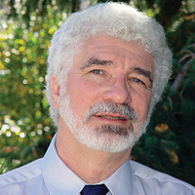
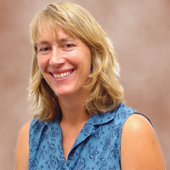
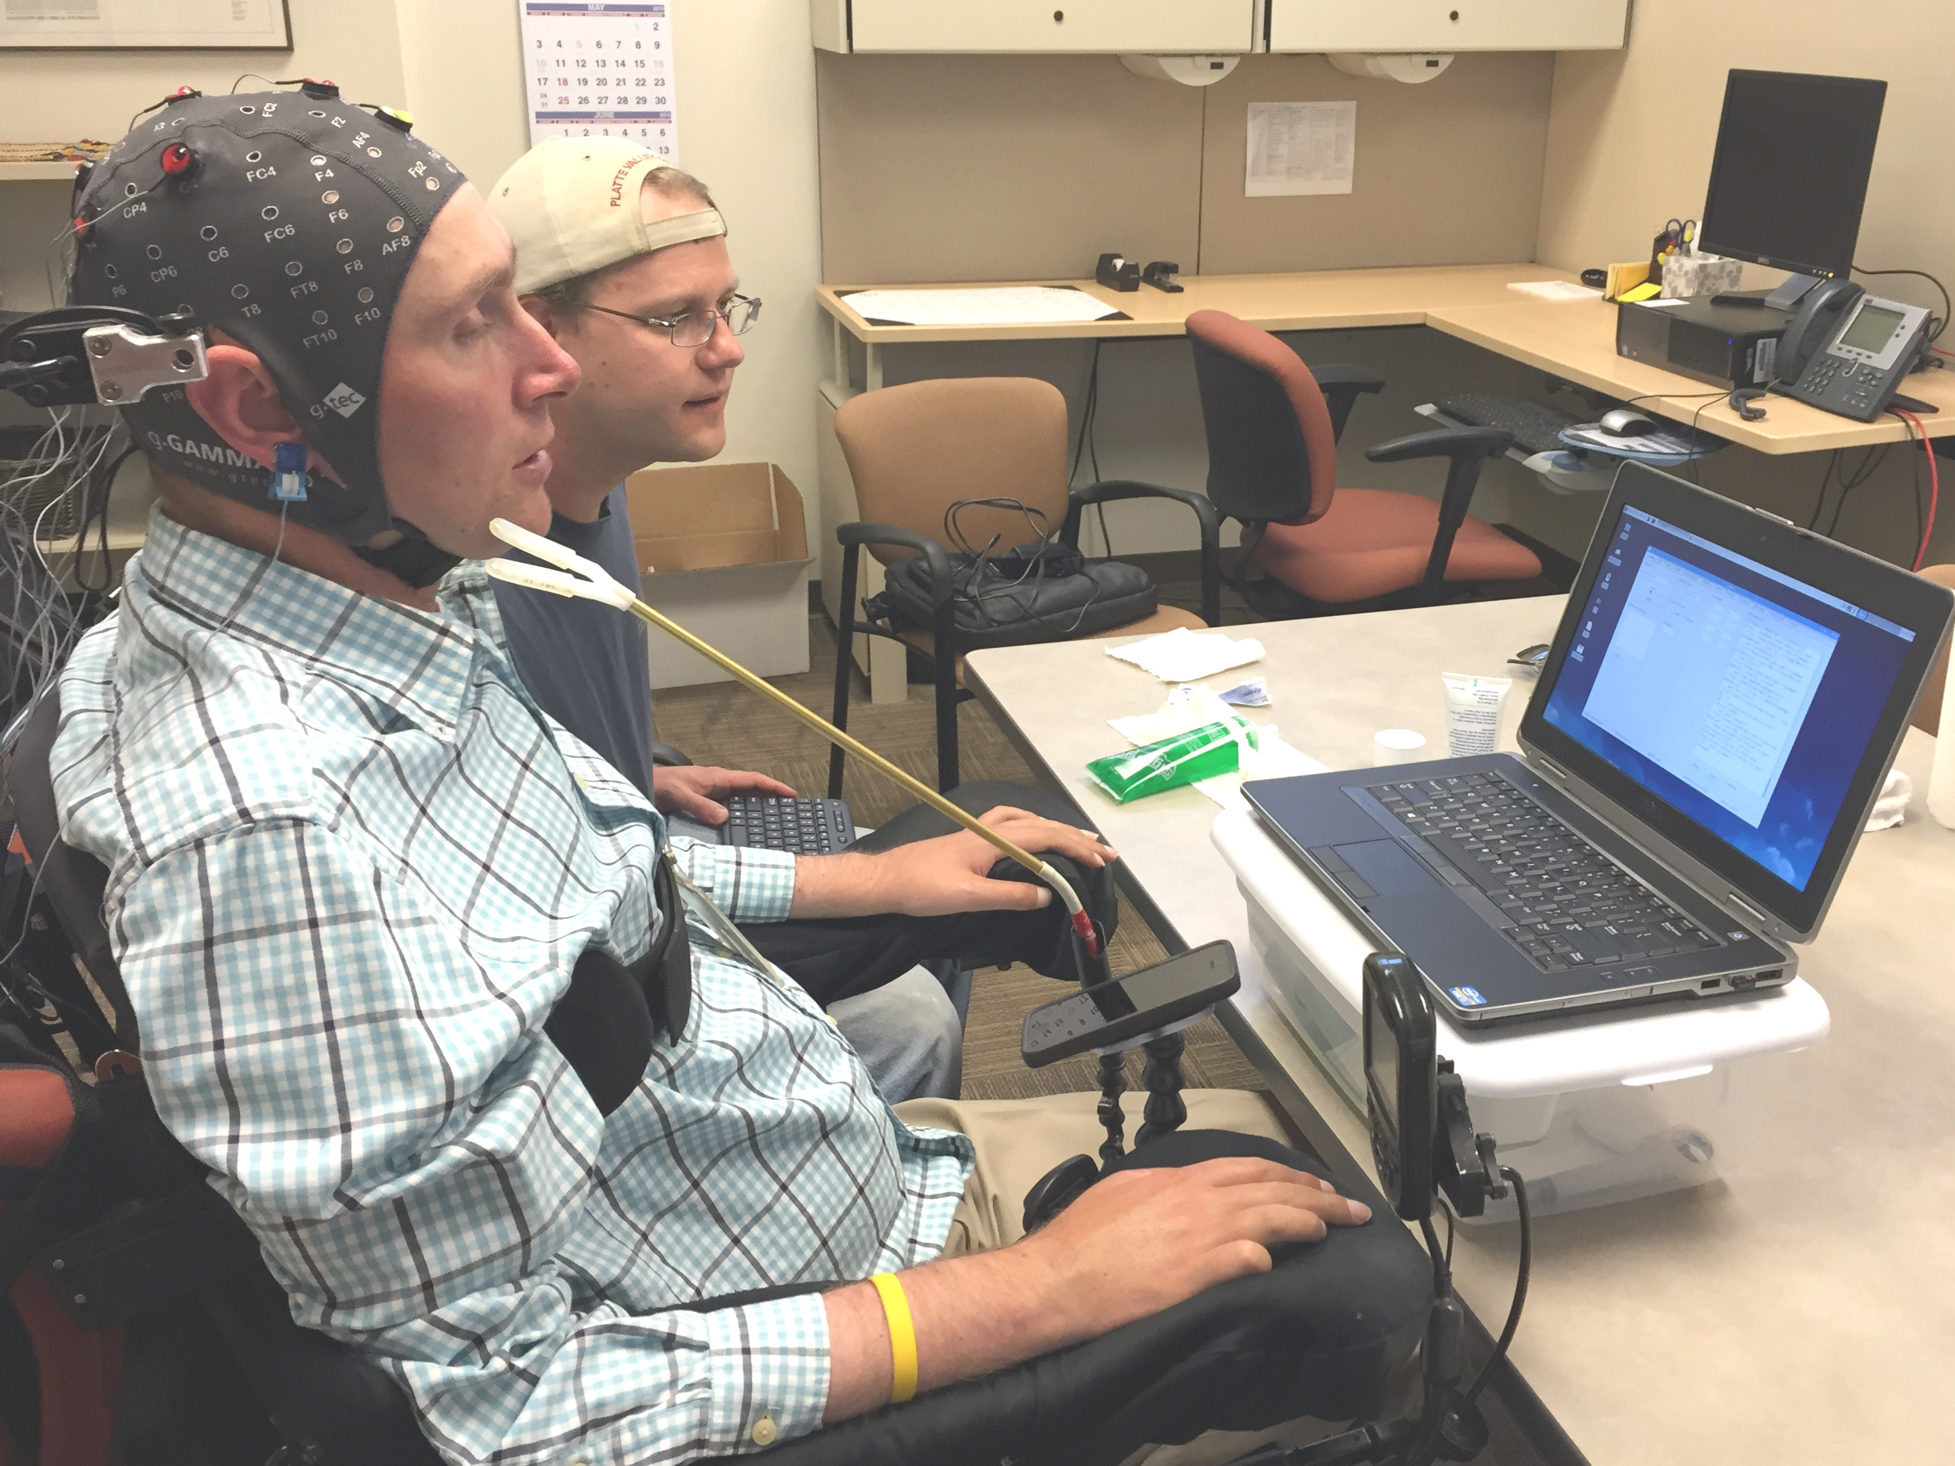
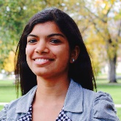
BCI Project at Colorado State University
PI: Chuck Anderson
Computer Science
Co-PI: Bill Gavin
Human Development & Family Studies
Co-PI: Patti Davies
Occupational Therapy
Marla Roll, OTR
Assistive Technology
Resource Center
Elliott Forney
Computer Science
Brittany Taylor Jewel Crasta
Brainwaves Research Lab
Colin Heffern

Slide 5
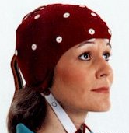
What is a Brain-Computer Interface?
Digitized
EEG
EEG Recording
System
Feature
Extraction
Translation
voltages
from
scalp
electrodes
command
Replace lost function
Restore lost function
Enhance impaired performance
Supplement current function
Improve brain activity through activity dependent plasticity
BCI Application

Slide 6
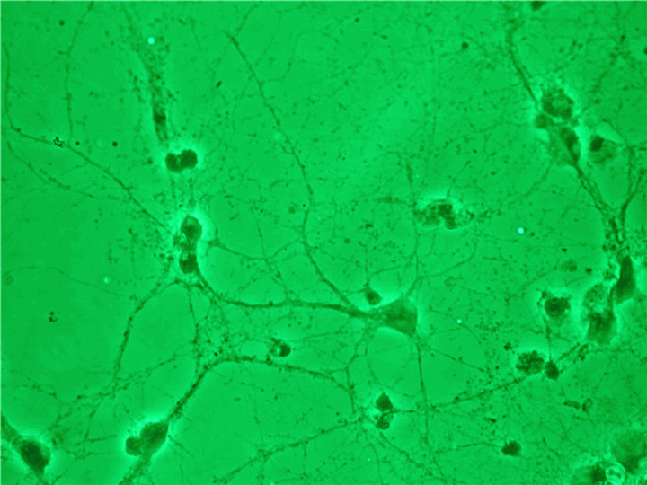
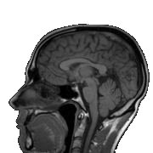
Brainwaves (EEG)
Our brains are composed of neurons that interact electrically and chemically. The activity of one neuron cannot be measured on the scalp.
When a large number of neurons (100,000's) in a small region of the outer layer (cerebral cortex) are active together, the sum of their electric currents becomes strong enough to be measured on the scalp.
Electroencephalography (EEG) is the measurement of weak electric potentials on the scalp. 10-50 microvolts

Slide 7
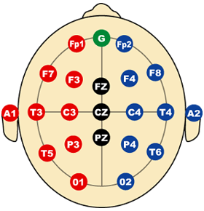
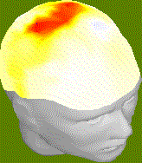
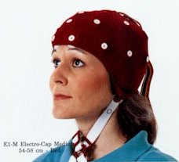
EEG at Different Scalp Locations
EEG is measured at electrodes
placed at multiple scalp locations
Standard 10-20 System for
electrode positions
EEG activity changes quickly.
one second of EEG
EEG at multiple electrodes
positive negative
http://butler.cc.tut.fi/~malmivuo/bem/bembook/13/13.htm
Morris and Maisto, Psychology: An Introduction

Slide 8
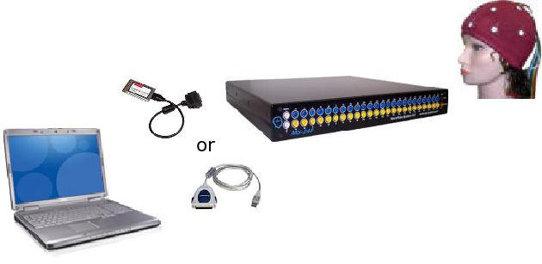
Inexpensive
EEG Recording System
ElectroCap International, Inc.
NeuroPulse-Systems, LLC
Adaptec SCSI adapter
Laptop computer
$ 7,630

Slide 9
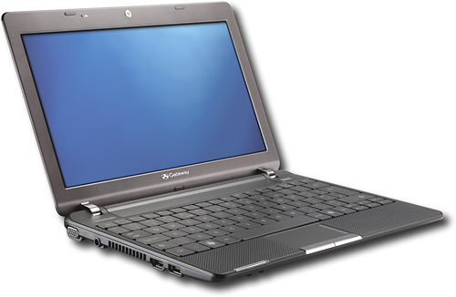
Moderately-Expensive
EEG Recording System
Guger Technologies (www.gtec.at)
wireless connection to laptop (bluetooth)
battery powered
active electrodes
$ 12,000
$ 12,000

Slide 10
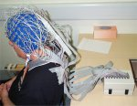
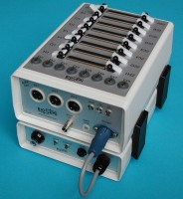
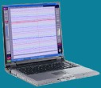
Expensive
EEG Recording System
Biosemi Active-2
Active 2 AD-box
32 electrodes
Active-electrodes
Battery box
Laptop computer
$40,000

Slide 11
EEG Recording Systems
 | Neuropulse Mindset-24R | g.tec MOBIlab+ | BioSemi Active Two
EEG channels | 19 | 8 | 32
AUX channels | 5 | none | 8
trigger port | no | yes | yes
Max Sampling Rate | 512Hz | 256Hz | 16384HZ
Max Bandwidth | 1.5 -34Hz | 0.5-100Hz | DC-3276.8Hz
Communication | SCSI | bluetooth | USB/fiber-optic
Cost (USD) | 7,630 | 12,000 | 40,000

Slide 12
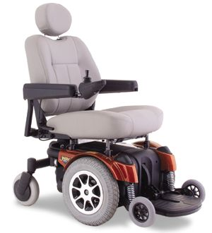
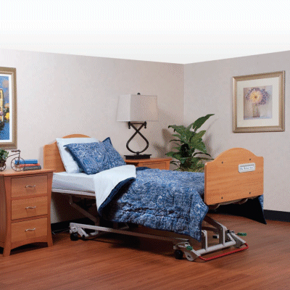
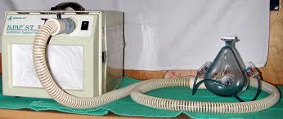
Electrical Interference from Medical Equipment?
Power wheelchair
Hospital bed
Respirator

Slide 13
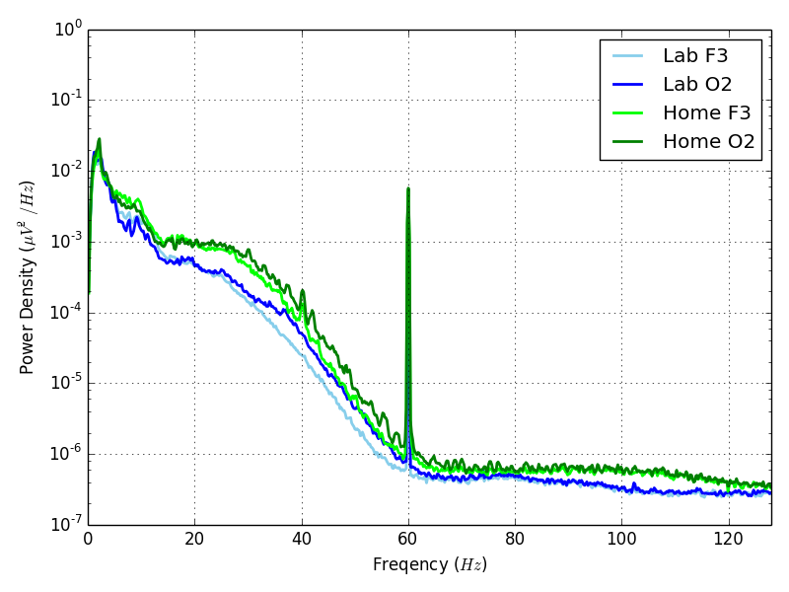
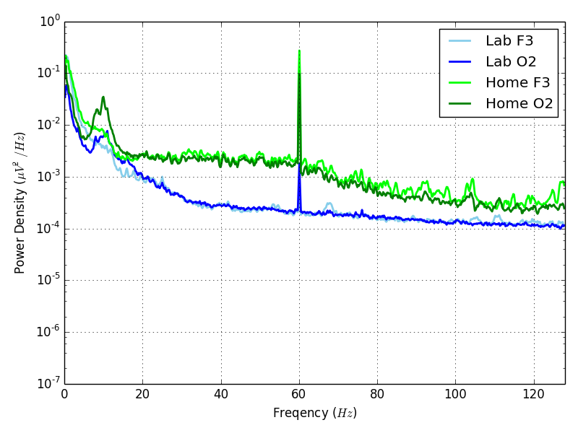
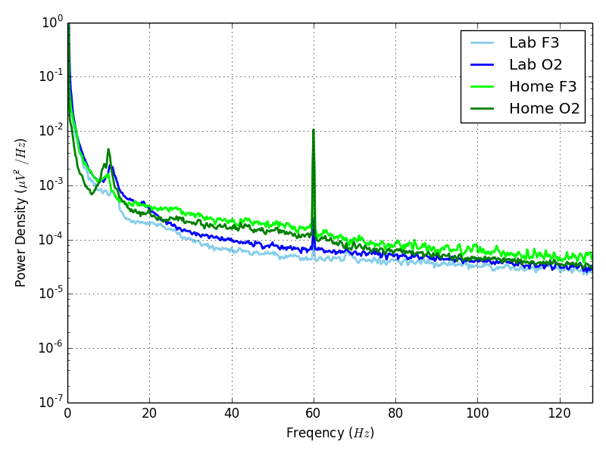
EEG Recording Systems
more expensive

Slide 14
What is a Brain-Computer Interface?
Digitized
EEG
EEG Recording
System
Feature
Extraction
Translation
voltages
from
scalp
electrodes
command
BCI Application

Slide 15
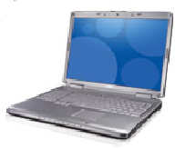
Types of User Interaction
Mental Task
spontaneous
versus
stimulus driven

Slide 16
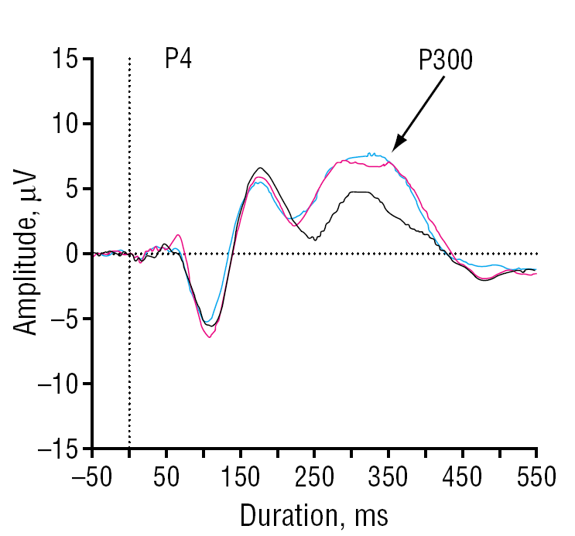
Stimulus Driven
Visual stimulus is rare but expected
For example, looking for an A:
D E F X A J L T A . . .
When A appears, EEG signal will contain a P300 wave, a Positive deflection 300 ms after stimulus
Must average the EEG over multiple trials to detect the P300 wave
stimulus
Winterer, et al., Arch Gen Psychiatry, 2003;60:1158-1167.

Slide 17
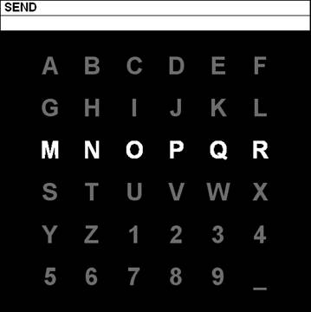
Typing using the P300
In 1988, Donchin developed use of P300 for typing application.
Row or column chosen randomly and highlighted about 5 times a second.
Subject looks at desired letter.
When row or column containing the letter lights up, P300 wave occurs.
Reliable detection requires averaging over 15 trials
Remains the most common brain-computer interface
1988: Farwell and Donchin, Electroencephalogr. Clin. Neurophysiol., vol. 70, pp. 510–523.
http://ida.first.fraunhofer.de/projects/bci/competition_ii/albany_desc/albany_desc_ii.html

Slide 18
Typing using P300
http://www.gtec.at

Slide 19
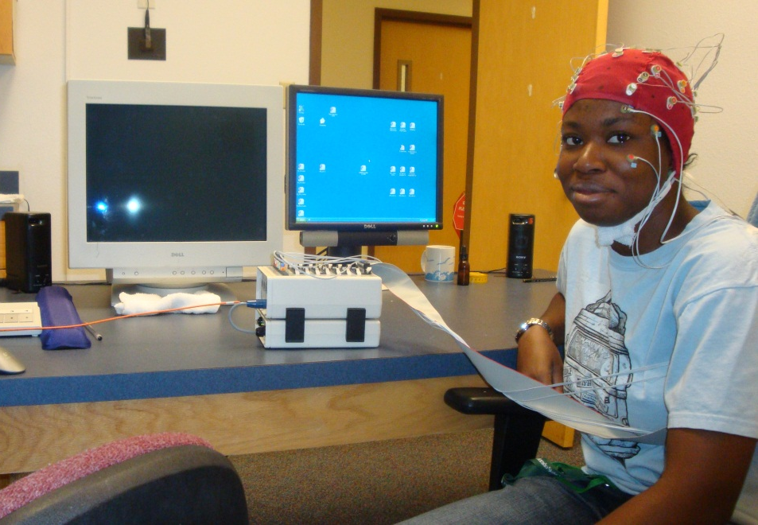
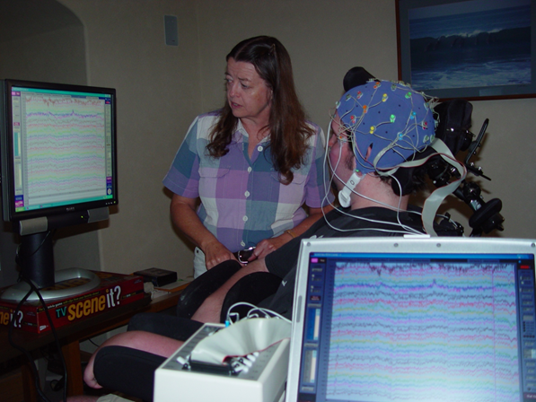
Our Approach:
BCI in Real-Life Situations
Adults with no impairments
Data collected in the lab
Adults with severe motor impairments
Data collected in the homes of the clients

Slide 20
Electrical Interference from Medical Equipment?
Power wheelchair
Hospital bed
Respirator

Slide 21
P300 Spelling Accuracy in Lab and Home
Single letter appears
Count a target letter
b, p, d
20 - each target letters
20 - non-target letters

Slide 22
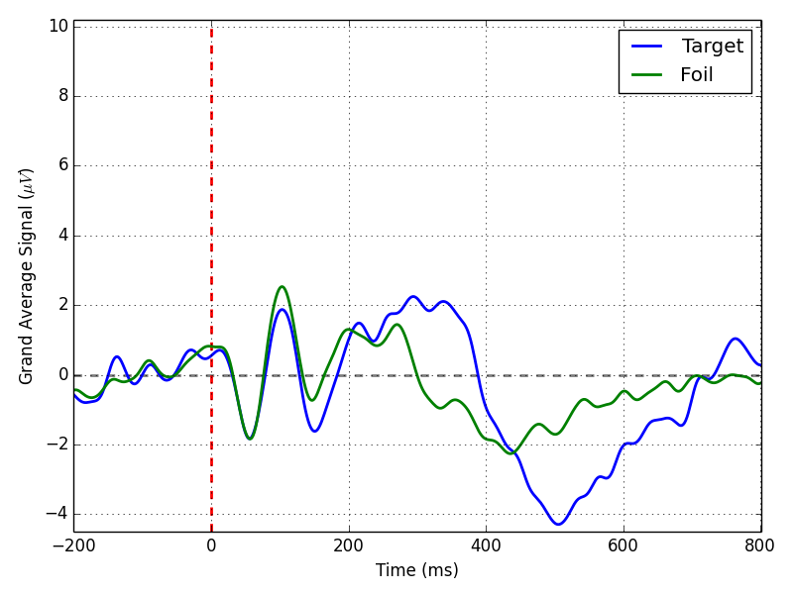
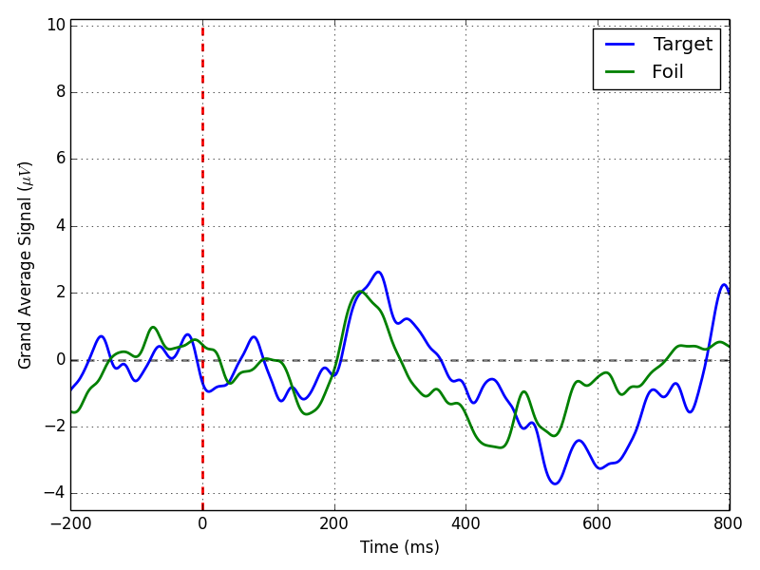
Inexpensive EEG system
(Neuro-pulse)
Adults without impairments
Clients

Slide 23
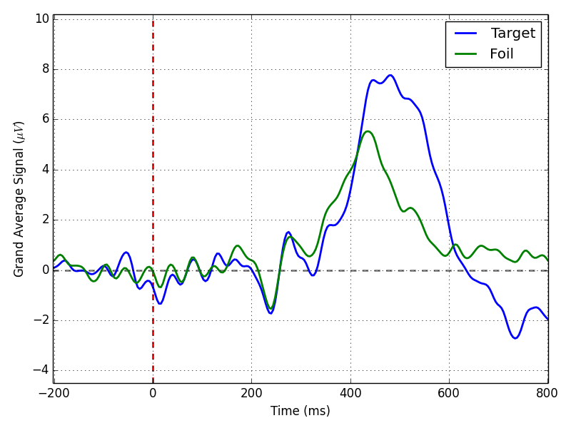
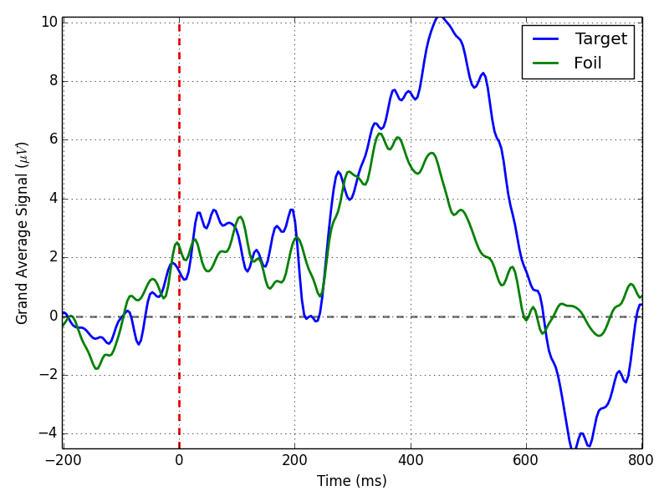
Moderately-Expensive EEG system
(G.Tec)
Adults without impairments
Clients

Slide 24
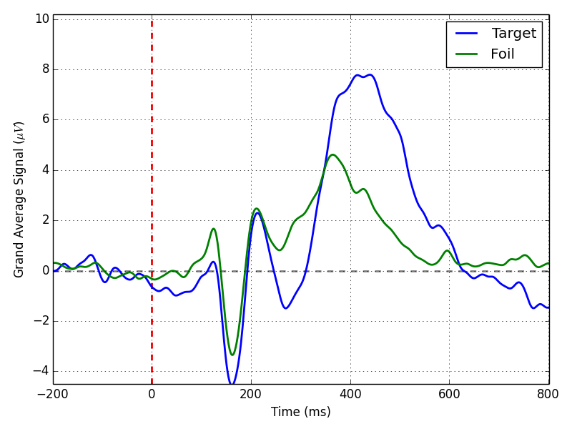
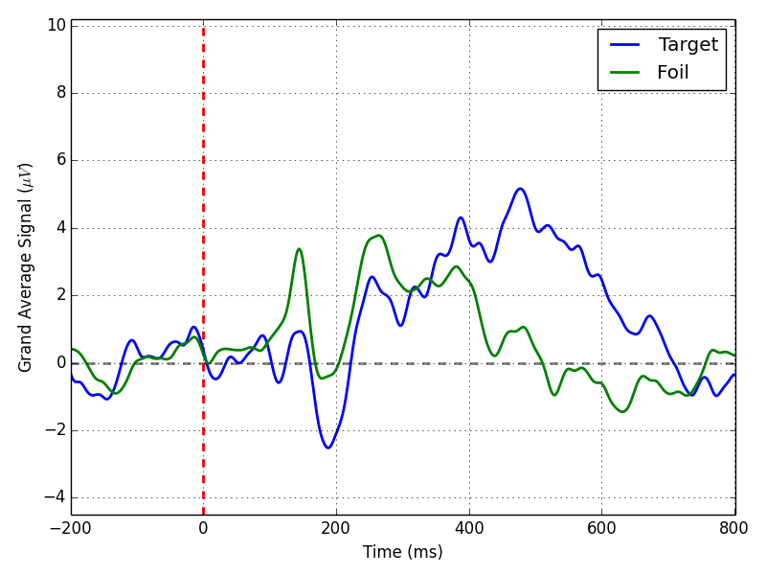
Expensive EEG system
(Biosemi)
Adults without impairments
Clients

Slide 25
Accuracy of Selecting Correct Letter
 | Neuro-Pulse | G.Tec | Biosemi
1 | 76 % | 63 | 84
2 | 84 | 80 | 82
3 | 96 | 68 | 88
4 | 68 | 75 | 75
5 | 66 | 74 | 89
6 | 83 | 77 | 62
7 | 75 | 70 | 79
8 | 73 | 70 | 91
9 | 78 | 73 | 70
Average | 76 | 72 | 80
10 | 64 |  | 63
11 |  | 85 | 65
12 | 90 | 92 | 89
13 | 45 |  | 73
14 | 74 | 60 | 71
15 | 73 | 70 | 90
16 | 63 | 76 | 69
Average | 68 | 77 | 74
Subjects with no impairments in lab
Clients in homes

Slide 26
Types of User Interaction
Mental Task
spontaneous
versus
stimulus driven

Slide 27
Wheelchair Control with Mental Tasks
MAIA Project. Jose del R. Millan, IDIAP, Switzerland.
Imagined right hand to turn right
Imagined left foot to turn left
Imagine words starting with same letter to go forward
sensing built into wheelchair prevents collisions
Vanacker, Millan, et al., Computational Intelligence and Neuroscience, 2007, Article ID 25130

Slide 28
Mental Task Accuracy in Lab and Home
Cube - Visualize a spinning cube
Count - Silently count backwards from 100 by 3’s
Fist - Imagine clenching right hand into a fist
Song - Silently sing a favorite song
Perform each one for 10 seconds.
Each task repeated 5 times.

Slide 29
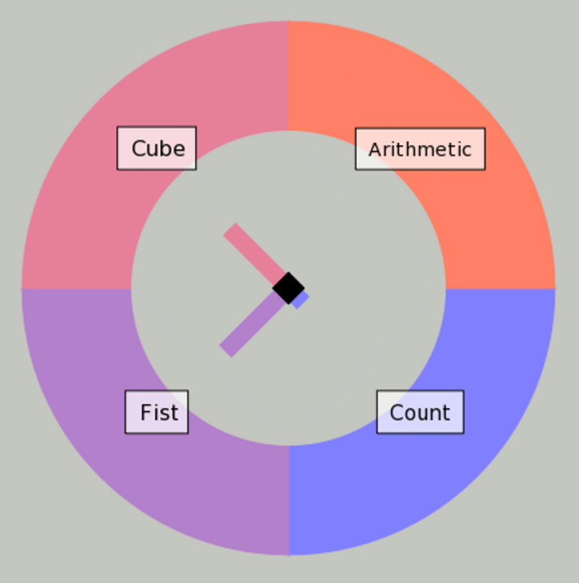
Accuracy of Detecting Correct Mental Task
 | G.Tec
1 | 85 %
2 | 80
3 | 90
4 | 95
5 | 65
6 | 95
7 | 70
8 | 95
9 | 75
Average | 83
10 | 40
11 | 70
12 | 50
13 | 88
14 | 60
Average | 62
Accuracy of detecting correct task from two choices.
Subjects with no impairments in lab
Song
Clients in homes

Slide 30
Summary
Type of EEG recording system does matter.
Accuracy of stimulus driven, P300 detection, ranges from near chance to 96 % accuracy.
Classification of mental tasks ranges from just above chance to 90 % accuracy.
Classification of brain signals is not as accurate for persons with motor impairments as it is for adults without impairments.
With the correct EEG equipment, BCI systems can be used in the homes of clients.
Custom software that is easily modified for interaction type and application is key.

Slide 31
Overview of Workshop
Introduction to Brain-Computer Interfaces (30 minutes)
What is a brain-computer interface (BCI)?
What are brainwaves (EEG)?
What are current BCI applications and their limitations?
How are we making BCI more practical?
The End-User Perspective (15 minutes)
Questionnaire and results
Gathering your input
Demonstration (15 minutes)
Using BCI to select and play music
Discussion (15 minutes)

Slide 32
The End-User Perspective
Marla Roll
TOBI Short questionnaire for End-Users
End-users were asked to rate their satisfaction with current AT solutions in the domains of mobility, manipulation, communication, computer access & environmental control on a four point Likert scale (EU project for Brain Computer Interaction)
Colorado State University BCI Questionnaire for End-Users
Gathered a broad range of information related to end-users likes and dislikes, ways it could increase participation in daily activities and overall usability
Both were administered to a convenience sample of 7 subjects connected to the Assistive Technology Resource Center at Colorado State University

Slide 33
TOBI Questionnaire Results
80 % of subjects felt the most important aspects of BCI were:
Ease of use
Functionality
Adaptability and portability
Least important considerations were:
Price
Aesthestics
Fatigue (mental and physical)

Slide 34
CSU BCI Questionnaire Results
5 subjects felt they could use BCI comfortably for up to 4 hours/day
5 subjects preferred the mental tasks over the stimulus drive, P300 spelling task
All subjects’ likes for BCI were future oriented with a hope that BCI could get better
Strongest dislike for the BCI system wsa use of the EEG cap

Slide 35
Questionnaire Overlap
Both questionnaires queried subjects on what would improve their independence (TOBI) and participation (CSU).
Mobility was most important aspect in regard to a BCI application.
Relationship with a partner or family and friends wsa next in importance.

Slide 36
Gathering the
AT Professional/Caregiver Perspective
We need and want your input:
Brief survey and synthesis:
On-line survey: (TOBI Short Questionnaire for Professional Users)
http://www.surveygizmo.com/s3/2164106/TOBI
1. What AT gap does BCI fill?
2. What BCI application do your patients/clients need?
3. What is/are the barriers for BCI becoming a useful AT?

Slide 37
Overview of Workshop
Introduction to Brain-Computer Interfaces (30 minutes)
What is a brain-computer interface (BCI)?
What are brainwaves (EEG)?
What are current BCI applications and their limitations?
How are we making BCI more practical?
The End-User Perspective (15 minutes)
Questionnaire and results
Gathering your input
Demonstration (15 minutes)
Using BCI to select and play music
Discussion (15 minutes)

Slide 38
BCI Demonstration
Elliott Forney and Colin Hefner
EEG Recording System – G.Tec
Software – Custom, extendable, python
P300 detection to select music to play

Slide 39
Overview of Workshop
Introduction to Brain-Computer Interfaces (30 minutes)
What is a brain-computer interface (BCI)?
What are brainwaves (EEG)?
What are current BCI applications and their limitations?
How are we making BCI more practical?
The End-User Perspective (15 minutes)
Questionnaire and results
Gathering your input
Demonstration (15 minutes)
Using BCI to select and play music
Discussion (15 minutes)

Slide 40
Discussion
Was this workshop a success?
Participants will understand the kind of equipment necessary for BCI by observing the live demonstration.
Participants will be able to identify at least three limitations of current BCI systems.
Participants will understand the potential utility of BCI systems as assistive technology.
http://www.surveygizmo.com/s3/2164106/TOBI

Slide 41
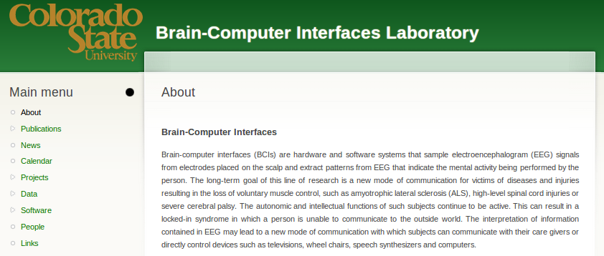
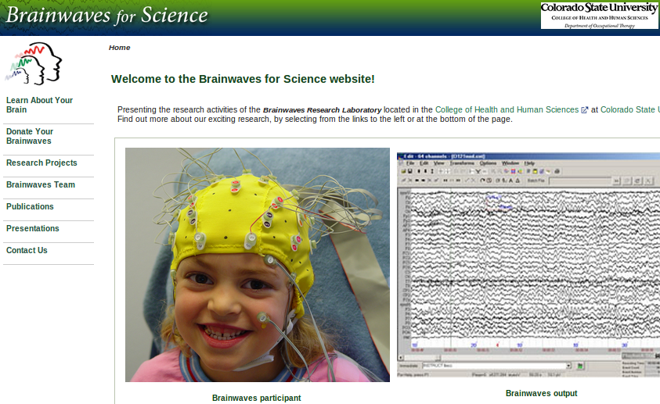
For More Information
http://www.cs.colostate.edu/eeg
http://brainwaves.colostate.edu
http://atrc.colostate.edu

Slide 42
Thank you
http://www.cs.colostate.edu/eeg
http://brainwaves.colostate.edu/
http://atrc.colostate.edu
http://www.surveygizmo.com/s3/2164106/TOBI

