Slide 1
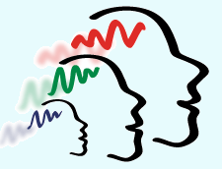
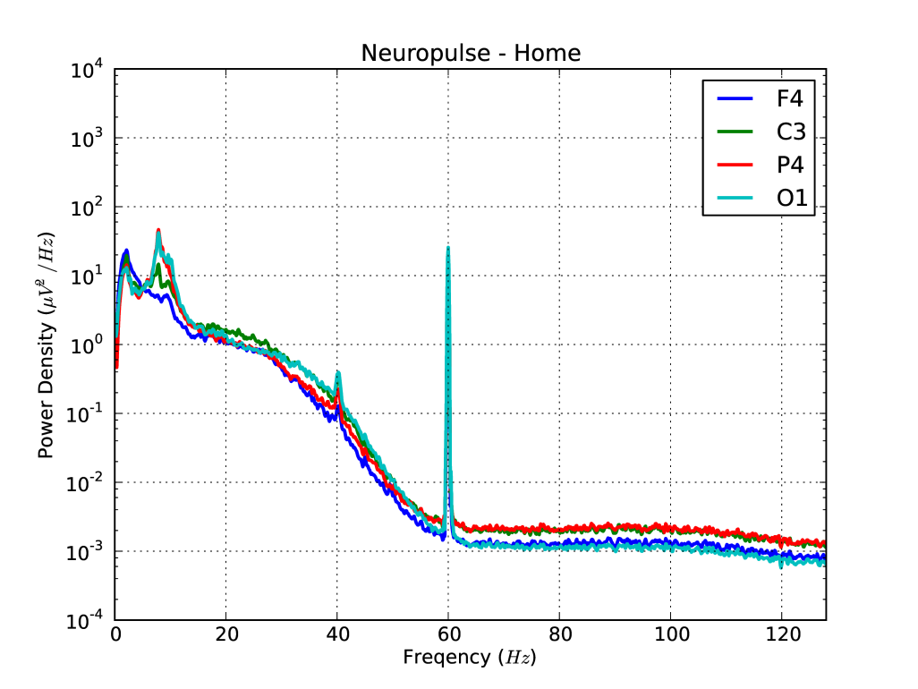
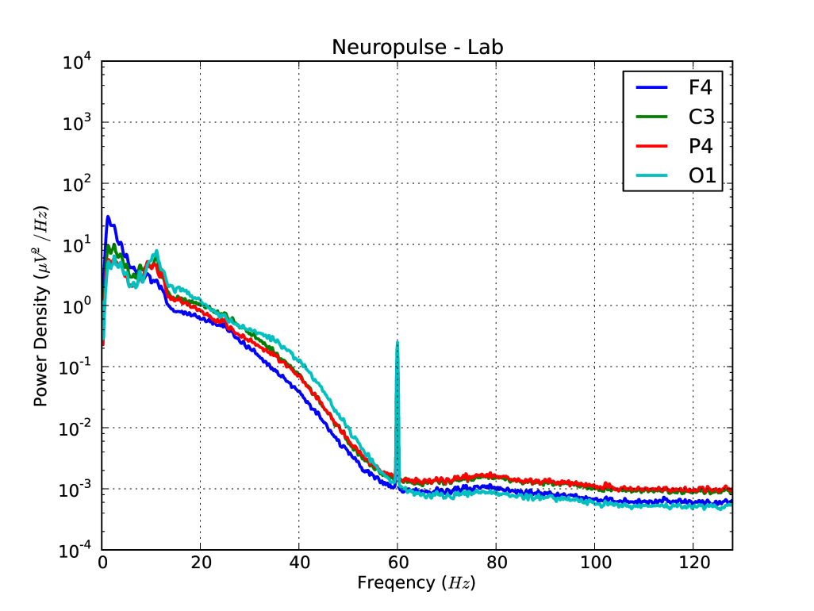
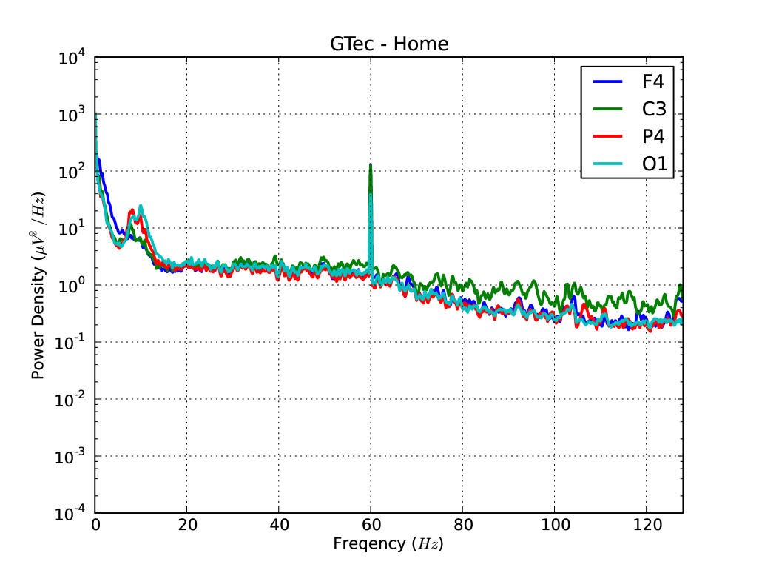
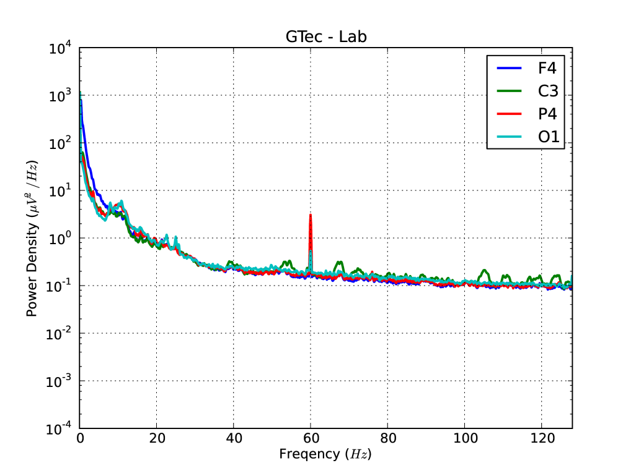
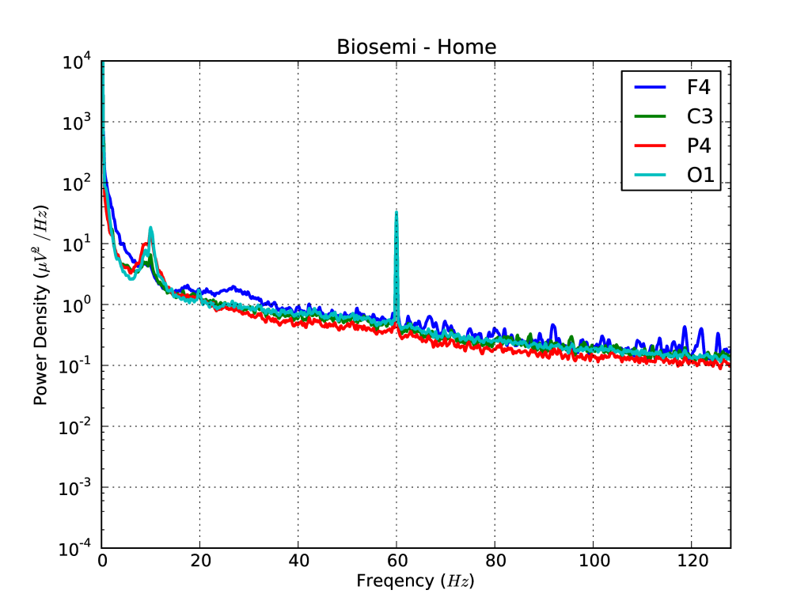
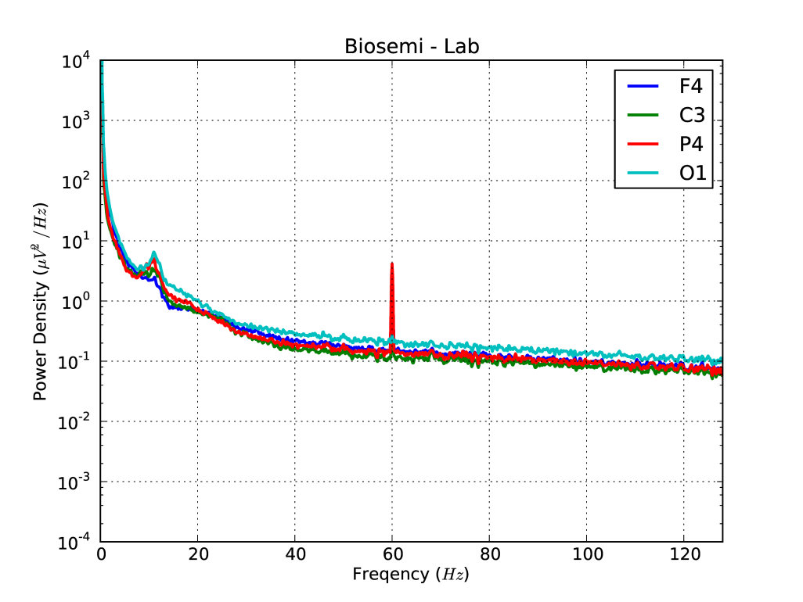
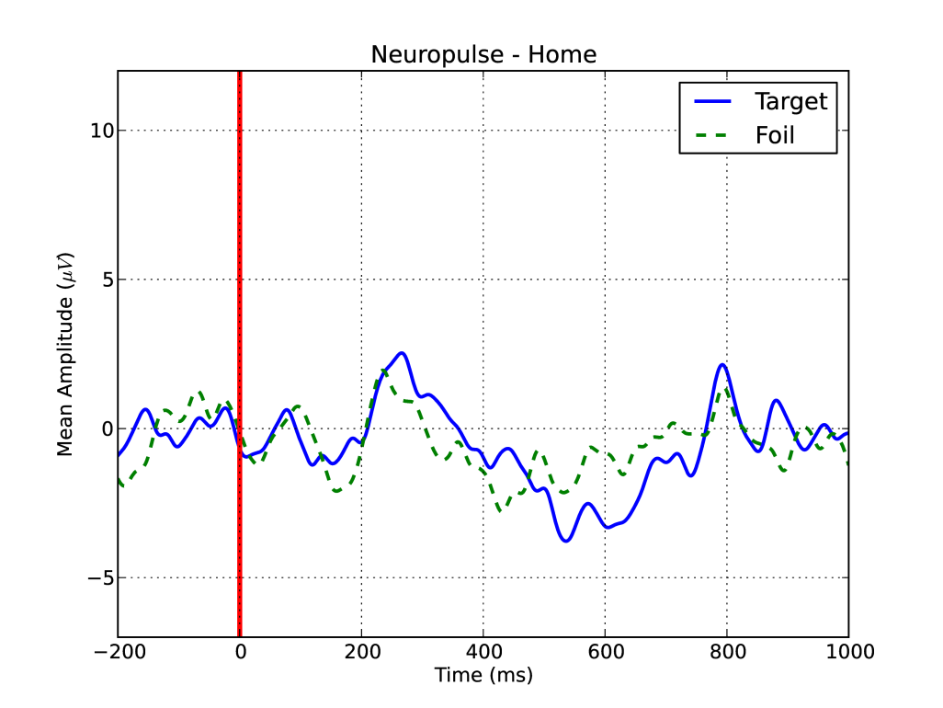
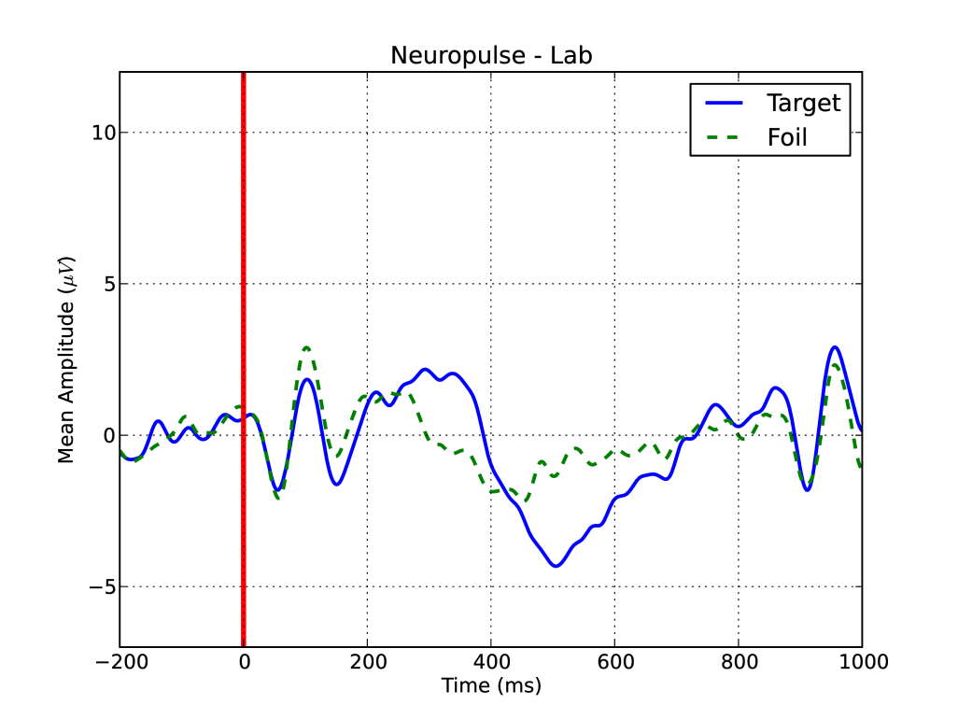
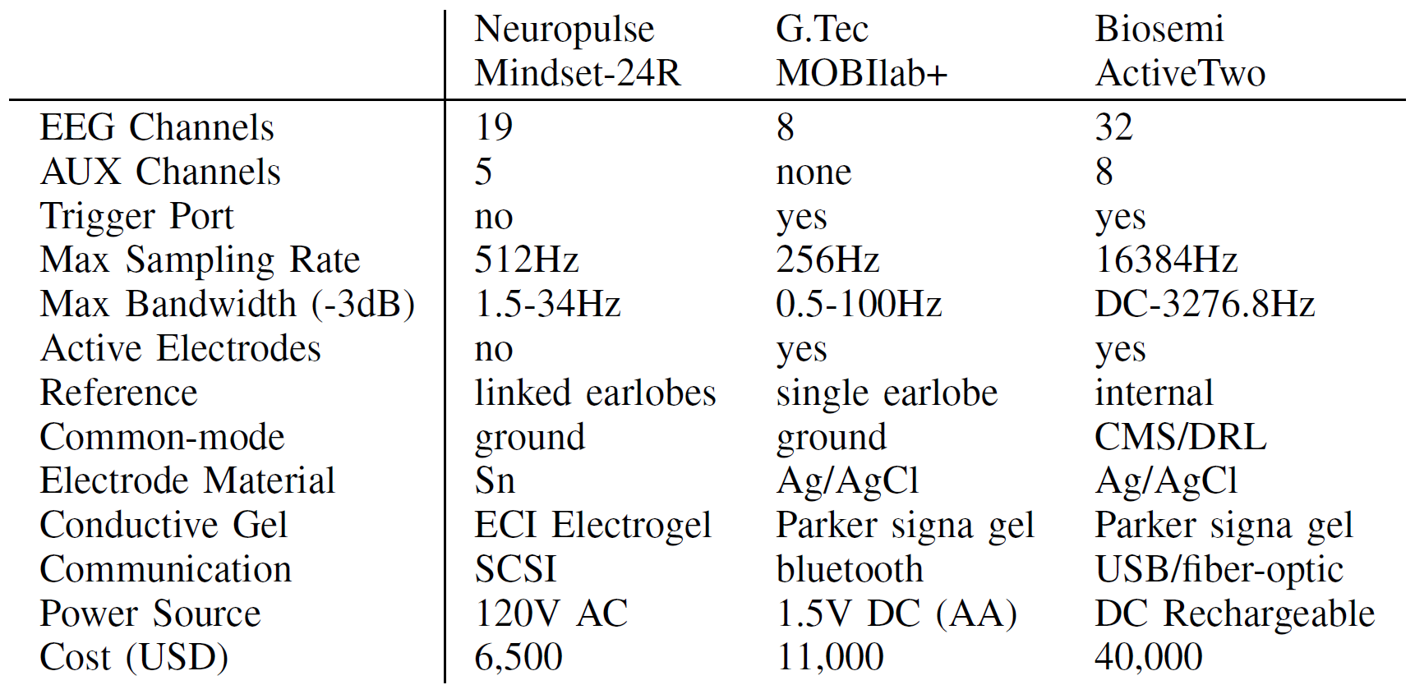
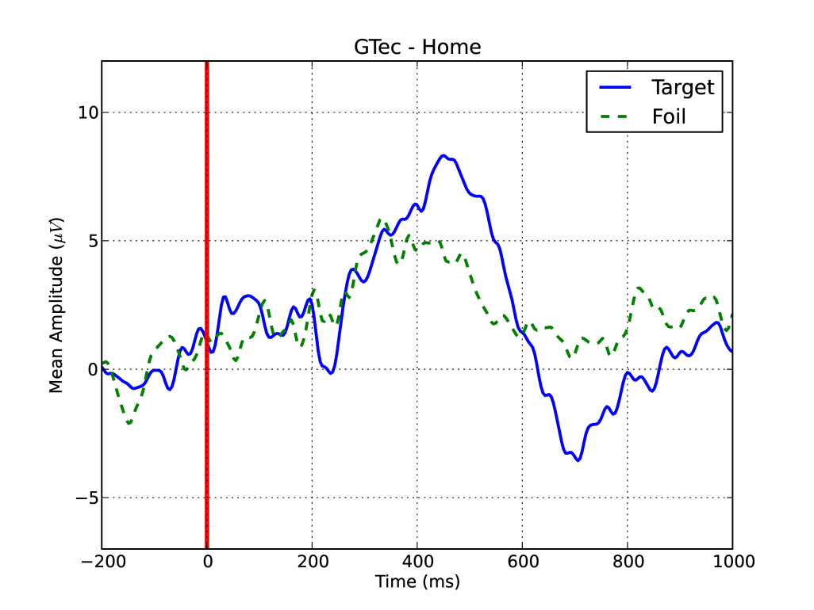
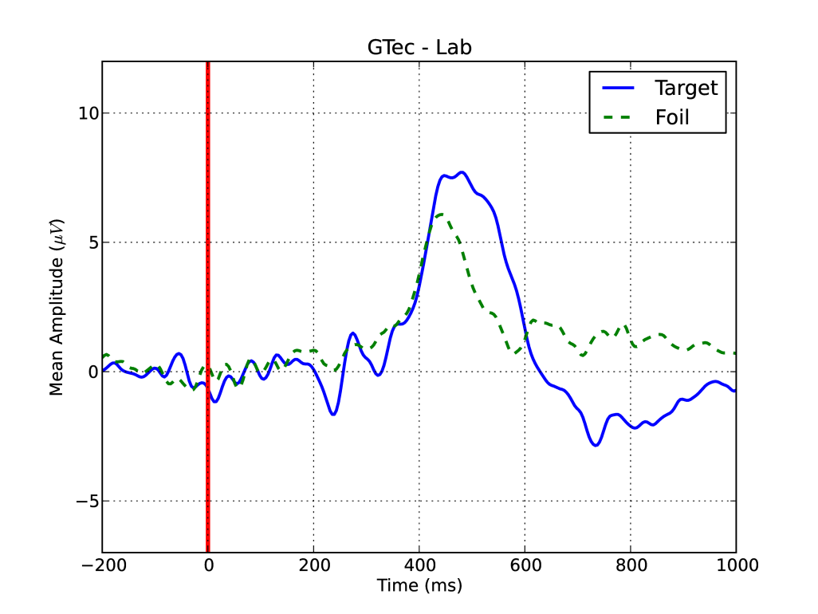
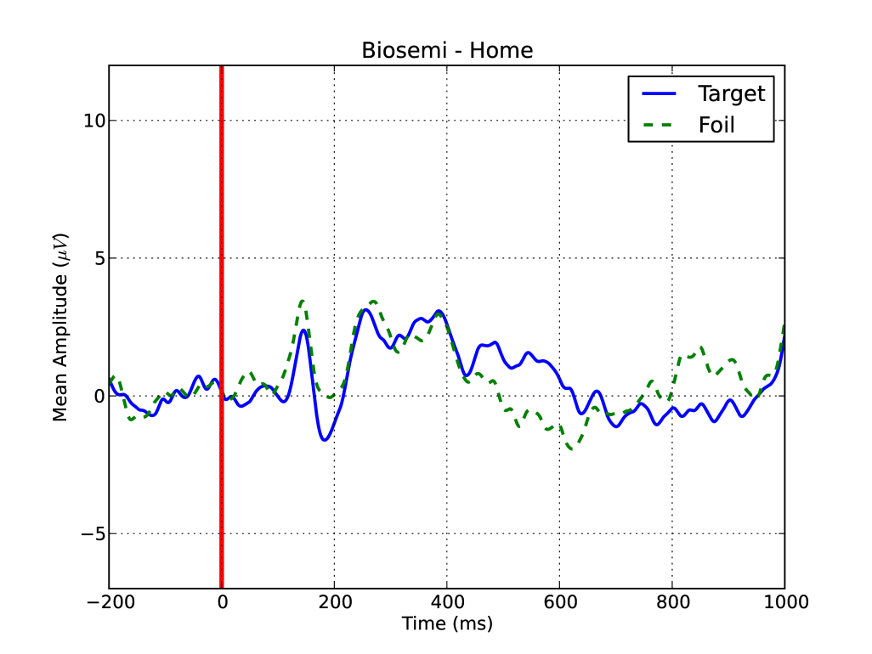
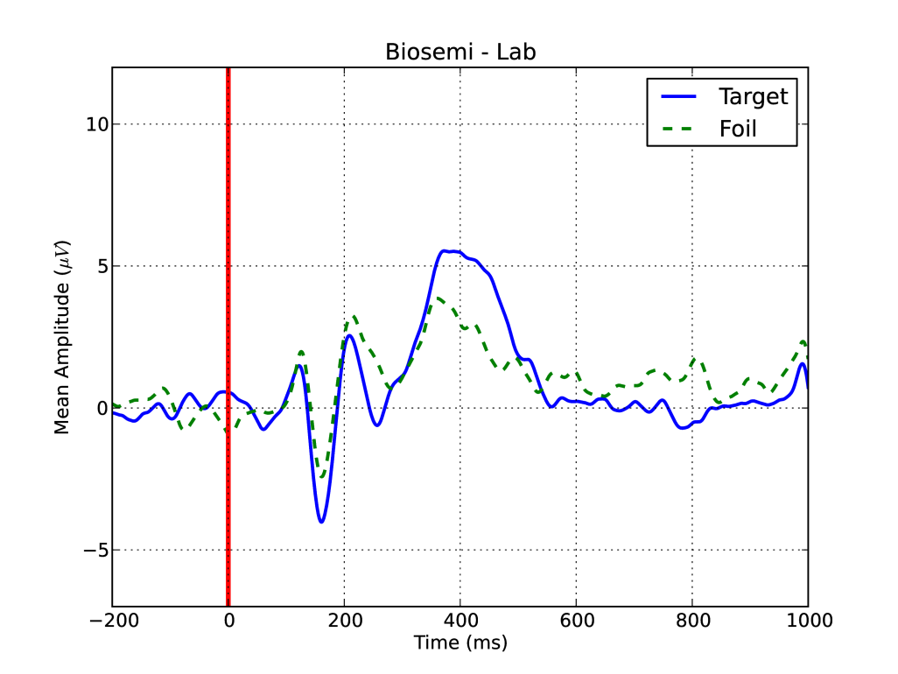
Comparison of EEG Systems for use with Brain-Computer Interfaces
in Home Environments
Brainwaves Research Lab
Grant Number
1065513
Brittany K. Taylor, Elliott M. Forney, Charles W. Anderson, Patricia L. Davies, William J. Gavin
Colorado State University, Fort Collins, CO
Introduction
Methods
Results
Conclusions
What is BCI
Brain-computer interfaces (BCI) are used to establish a direct channel of communication between a user’s brain and a computer system.
Using electroencephalography (EEG), users can simply alter their mental state in order to operate various computerized devices, such as remote controls, motorized wheelchairs, and communication devices.
This is ideal for individuals with motor impairments because users only have to alter their mental state to operate the device.
These systems show great promise, however they are often only tested in laboratory settings.
P300 Speller
A P300 is a positive voltage deflection in EEG found 300ms after the presentation of a rare but expected stimulus.
This waveform has been associated with cognitive processing of a stimulus.
A serial P300 speller operates by presenting a series of flashing characters, in this case letters, to the user.
When a target character is flashed, we expect the user to exhibit a P300 response.
P300 spellers can be displayed with single characters (Figure 1), or in a grid format (Figure 2).
Participants
7 adults with severe motor impairment.
9 adults with no motor impairment.
Each participant was asked to utilize three different EEG systems during three separate recording sessions.
For individuals with severe motor impairments, EEG recording sessions were performed in the users’ homes.
Individuals with no motor impairments performed their EEG recording sessions in a laboratory setting.
P300 Speller Paradigm
In the present study, we are investigating the single letter, serial P300 speller paradigm.
Participants were seated comfortably behind an LCD computer screen.
Letter characters flashed in the center of the screen one at a time with a stimulus duration of 100ms.
There was an inter-stimulus interval of 750ms between each letter presentation.
Participants were instructed to count the number of presentations of a predetermined target letter (p, b, or d).
There were 20 target characters out of 80 total presentations in each experiment block.
Participant performed the task in three blocks – one block per target letter.
EEG Systems
For each subject, data was recorded using three different EEG acquisition systems.
Each system differed with respect to cost, portability, ease of use, sampling rate, and number of electrodes (Table 1).
Table 1. Comparison of EEG systems
The Neuropulse system is relatively affordable (Neuropulse ≈ $6500, G.Tec ≈ $11,000, Biosemi ≈ $40,000) and supports up to 24 channels. It is not portable since it requires external power. Low impedances are required at electrode sites making it more susceptible to artifacts and making the cap more difficult to apply.
The G.Tec system has a midrange cost but only supports 8 channels. It is very portable with bluetooth communication and battery power. It has active electrodes allowing for high impedances, making the cap easy to apply and reducing susceptibility to interference.
The Biosemi system has a relatively high cost. It supports up to 40 channels and has a high bandwidth and high sampling rate. It is portable with rechargeable batteries and USB communication.
Power Spectral Density
Signal Quality
We found that it is possible to get clean, usable data with EEG systems in a home setting.
However, the data is much cleaner in lab settings.
The higher-end systems, e.g, G.Tec and Biosemi, appear to yield less noise in both home and laboratory environments.
P300 Responses
Overall, recordings from non-motorically impaired participants reveal more prominent P300 waveforms than motor-impaired participants, although P300s are visible in both groups.
Although P300 responses can be seen with all three EEG systems, the G.Tec system yields the most prominent peaks.
The Biosemi system is best able to capture the earlier, finer peaks in the waveform.
If these early responses prove useful in BCI applications, this may suggest that the Biosemi has an advantage.
It is possible to get usable P300 waveforms in a home setting, lending support to the use of P300 speller BCI in realistic settings.
As expected, there was higher observed 60Hz power in all three systems in the home compared to in the lab.
The greatest difference in 60Hz power between home and lab recordings was observed in the Neuropulse system.
There was greater observed broadband noise across the entire power spectrum in the home compared to in the lab, possibly due to muscle movement artifacts and excess electrical activity in the environment.
Overall, there are still quality signals recorded in the homes, although the lab recordings appear to be cleaner.
P300 Waveforms
Future Directions
Overall, lab recordings reveal more prominent P300 waveforms than home recordings, although they are still visible in both environments.
The Neuropulse system shows the least prominent P300s, possibly due to the high-valued high pass filter (1.5Hz).
Early sensory processing peaks are visible in all systems in both home and lab settings, though they appear the most prominent in the Biosemi system.
The Bluetooth data transfer in the G.Tec system may have disrupted the timing, thus reducing the visibility of some peaks.
Classification
The next step in our research is to apply machine learning algorithms to attempt to classify the target versus non-target EEG signals.
Previous work has suggested that linear, statistical classifiers, such as Linear Discriminant Analysis (LDA) perform well.
We plan to evaluate LDA as well as non-linear methods, such as Quadratic Discriminant Analysis and Artificial Neural Networks in order to evaluate their performance under real-world circumstances and with each EEG acquisition system.
Practical BCI
We would like to test our BCI systems with more participants in both home and lab settings.
It will be helpful to collect data on individuals with motor impairments in lab settings, and on individuals with no motor impairments in home settings.
Because of the visibility of early sensory peaks in the waveforms in both home and lab settings, it may be worthwhile to investigate the use of these peaks in place of the P300 to identify target letters.
Testing interactive, real-time BCI systems in home environments and among those with severe motor impairments is extremely important for determining how practical these systems may be.
Figure 1. Serial P300 speller
Figure 2. Grid P300 speller
Objectives
To compare different EEG systems in order to determine what qualities a system should have to make a successful BCI.
To utilize BCI in real-world conditions .
To investigate the performance of the P300 speller.

